Slide 1

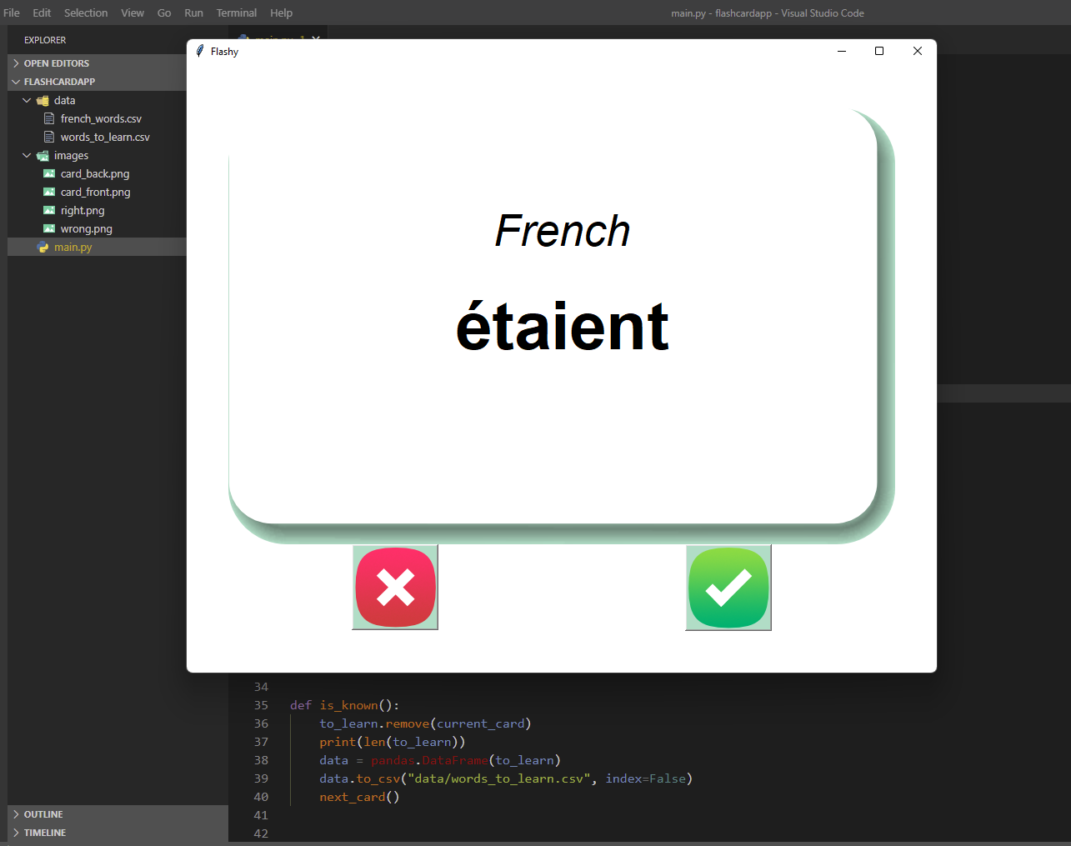
Flashcard
link to repository: https://github.com/ksu-is/flashcard
Flash card makes memorizations easier with a brief explanation or summarized definition of certain concepts or theory helps a lot and makes studying more efficient and effective
Tope Ogundeji

